Slide 1
Chapter 9
Reducing Project Duration

Slide 2
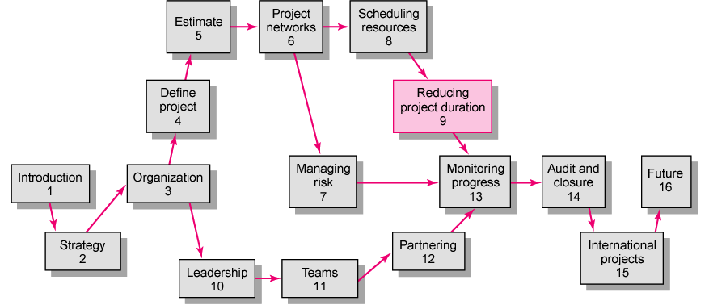
Copyright © 2006 The McGraw-Hill Companies. All rights reserved.
McGraw-Hill/Irwin 9–<number>
Notes:
This chapter is preceded by Chapter 8 – Scheduling resources and costs.
The purpose of chapter 8: ESTIMATE resources in terms of time, cost, man for the project
The purpose of this chapter

Slide 3
Reducing Project Duration
Rationale for Reducing Project Duration
Options for Accelerating Project Completion
Project Cost-Duration Graph
Constructing a Project Cost-Duration Graph
Practical Considerations
What if Cost, not Time, is the issue?
Key terms
Copyright © 2006 The McGraw-Hill Companies. All rights reserved.
McGraw-Hill/Irwin 9–<number>

Slide 4
Imagine the following scenarios:
After finalizing your project schedule, you realize the estimated completion date is two months beyond what your boss publicly promised an important customer.
Five months into the project, you realize that you are already three weeks behind the drop-dead date for the project.
Four months into a project top management changes its priorities and now tells you that money is not an issue. Complete the project ASAP!
Copyright © 2006 The McGraw-Hill Companies. All rights reserved.
McGraw-Hill/Irwin 9–<number>
Notes:
Imagine some cases as follow ➔ what would you do in one of these cases?
➔ try to find solutions to reduce the project duration!!!
This chapter addresses strategies for reducing project duration either prior to setting the baseline for the project or in the midst of project execution.

Slide 5
Rationale for Reducing Project Duration
Time Is Money: Cost-Time Tradeoffs
  Reducing the time of a critical activity usually incurs additional direct costs.
    Cost-time solutions focus on reducing (crashing) activities on the critical path to shorten overall duration of the project.
  Reasons for imposed project duration dates:
    Customer requirements and contract commitments
    Time-to-market pressures
    Incentive contracts (bonuses for early completion)
    Unforeseen delays
    Overhead and goodwill costs
    Pressure to move resources to other projects
Copyright © 2006 The McGraw-Hill Companies. All rights reserved.
McGraw-Hill/Irwin 9–<number>
Notes:
Electronics industry → Cell phone industry → cut market release time of new products from 12-18 months to 6-9 months

Slide 6

Options for Accelerating Project Completion
Adding Resources
Outsourcing Project Work
Scheduling Overtime
Establishing a Core Project Team
Do It Twice—Fast and Correctly
Fast-Tracking
Critical-Chain
Reducing Project Scope
Compromise Quality
Copyright © 2006 The McGraw-Hill Companies. All rights reserved.
McGraw-Hill/Irwin 9–<number>
Notes:
Column 1: If cost is not constrained
Column 2: If cost is constrained
- Fast–tracking: turn activity relationships from consequential into parallel/ concurrent
- Critical-chain: plan each activity, each movement in the project as critical → require closer coordination, perfectly smooth in performing

Slide 7
Explanation of Project Costs
Project Indirect Costs
  Costs that cannot be associated with any particular work package or project activity.
    Supervision, administration, consultants, and interest
  Costs that vary (increase) with time.
    Reducing project time directly reduces indirect costs.
Direct Costs
  Normal costs that can be assigned directly to a specific work package or project activity.
    Labor, materials, equipment, and subcontractors
  Crashing activities increases direct costs.
Copyright © 2006 The McGraw-Hill Companies. All rights reserved.
McGraw-Hill/Irwin 9–<number>

Slide 8
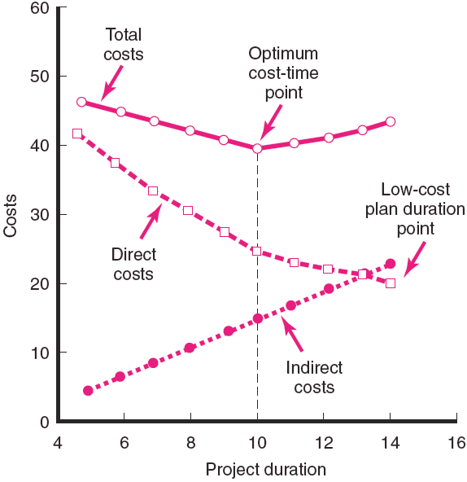
Project Cost—Duration Graph
FIGURE 9.1
Copyright © 2006 The McGraw-Hill Companies. All rights reserved.
McGraw-Hill/Irwin 9–<number>
Notes:
Project Cost-Duration graph presents the relationships between time and costs – including indirect, direct, and total cost.
You try to find each types of costs for each duration, point them to the graph and draw a line for each costs.

Slide 9
Reducing Project Duration to Reduce Project Cost
Identifying direct costs to reduce project time
Gather information about direct and indirect costs of specific project durations.
Search critical activities for lowest direct-cost activities to shorten project duration.
Compute total costs for specific durations and compare to benefits of reducing project time.
Copyright © 2006 The McGraw-Hill Companies. All rights reserved.
McGraw-Hill/Irwin 9–<number>

Slide 10
Constructing a Project Cost—Duration Graph
Find total direct costs for selected project durations.
Find total indirect costs for selected project durations.
Sum direct and indirect costs for these selected project durations.
Compare additional cost alternatives for benefits.
Copyright © 2006 The McGraw-Hill Companies. All rights reserved.
McGraw-Hill/Irwin 9–<number>

Slide 11
Constructing a Project Cost—Duration Graph
Determining Activities to Shorten
  Shorten the activities with the smallest increase in cost per unit of time.
  Assumptions:
    The cost relationship is linear.
    Normal time assumes low-cost, efficient methods to complete the activity.
    Crash time represents a limit—the greatest time reduction possible under realistic conditions.
    Slope represents a constant cost per unit of time.
    All accelerations must occur within the normal and crash times.
Copyright © 2006 The McGraw-Hill Companies. All rights reserved.
McGraw-Hill/Irwin 9–<number>

Slide 12
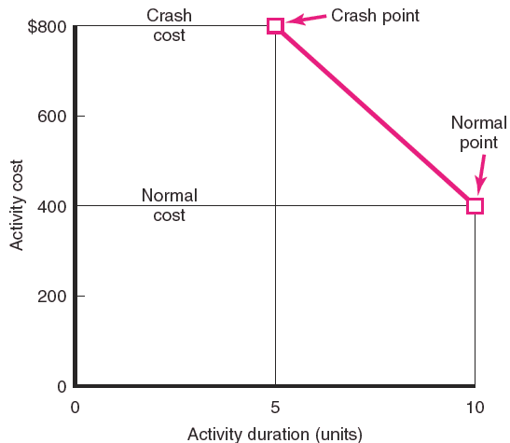
Activity Graph
FIGURE 9.2
Copyright © 2006 The McGraw-Hill Companies. All rights reserved.
McGraw-Hill/Irwin 9–<number>
Notes:
This graph represents the relationships between activity cost and time.
Normal activity cost in normal time condition
Crash cost in crash activity time condition. You cannot reduce the activity time any further the crash time.

Slide 13
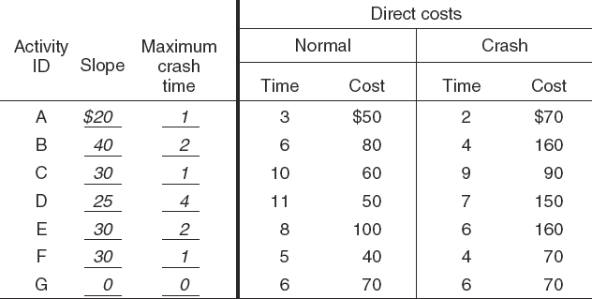
Cost—Duration Trade-off Example
FIGURE 9.3
Copyright © 2006 The McGraw-Hill Companies. All rights reserved.
McGraw-Hill/Irwin 9–<number>

Slide 14
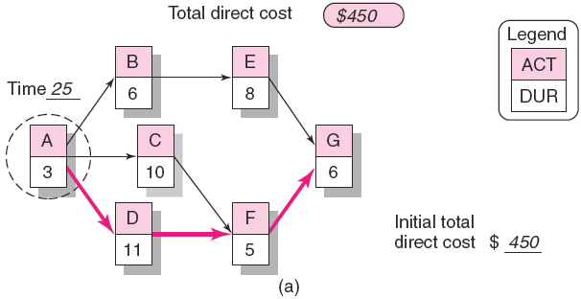
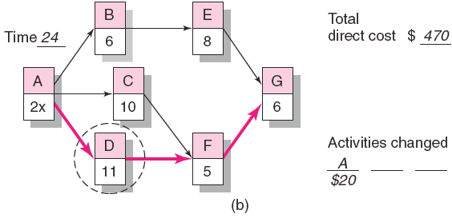
Cost—Duration Trade-off Example (cont’d)
FIGURE 9.3 (cont’d)
Copyright © 2006 The McGraw-Hill Companies. All rights reserved.
McGraw-Hill/Irwin 9–<number>

Slide 15
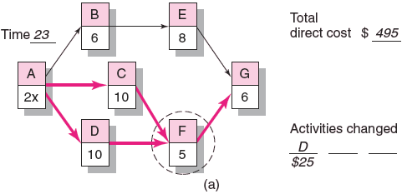
Cost—Duration Trade-off Example (cont’d)
FIGURE 9.4 (cont’d)
Copyright © 2006 The McGraw-Hill Companies. All rights reserved.
McGraw-Hill/Irwin 9–<number>

Slide 16
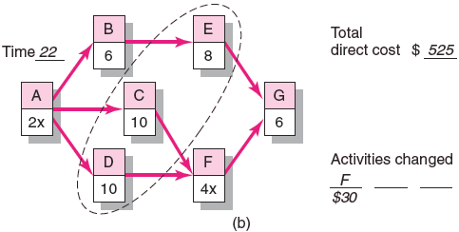
Cost—Duration Trade-off Example (cont’d)
FIGURE 9.4 (cont’d)
Copyright © 2006 The McGraw-Hill Companies. All rights reserved.
McGraw-Hill/Irwin 9–<number>

Slide 17
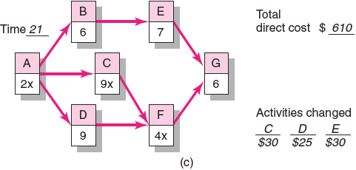
Cost—Duration Trade-off Example (cont’d)
FIGURE 9.4 (cont’d)
Copyright © 2006 The McGraw-Hill Companies. All rights reserved.
McGraw-Hill/Irwin 9–<number>

Slide 18
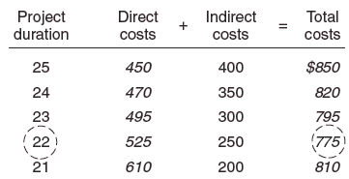
Summary Costs by Duration
FIGURE 9.5
Copyright © 2006 The McGraw-Hill Companies. All rights reserved.
McGraw-Hill/Irwin 9–<number>

Slide 19
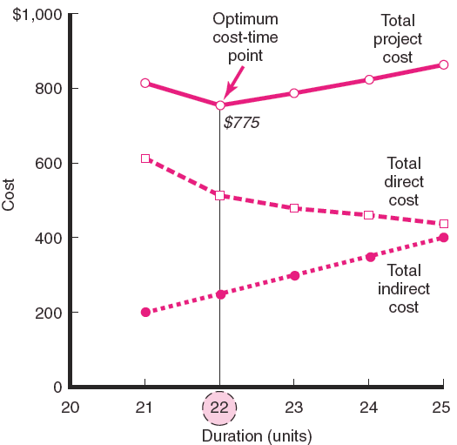
Project Cost—Duration Graph
FIGURE 9.6
Copyright © 2006 The McGraw-Hill Companies. All rights reserved.
McGraw-Hill/Irwin 9–<number>

Slide 20
Practical Considerations
Using the Project Cost—Duration Graph
Crash Times
Linearity Assumption
Choice of Activities to Crash Revisited
Time Reduction Decisions and Sensitivity
Copyright © 2006 The McGraw-Hill Companies. All rights reserved.
McGraw-Hill/Irwin 9–<number>
Notes:
Keep track on Indirect Cost prior the Decision ( Indirect Cost is often forgotten when the pressure for action in intense)
Hard to define crash time and cost correctively in reality
Because of hardness in defining crash time and cost, the curving relationship between time and cost is often overcome.
The cost-time crashing method relies on choosing the cheapest method for reducing the duration of the project. There are other factors that should be assessed beyond simply cost (risk, timing of activities, over-allocation resources)
The optimum cost-time point is also considered in the relationship with risk.

Slide 21
What if Cost, Not Time is the Issue?
Commonly Used Options for Cutting Costs
  Reduce project scope
  Have owner take on more responsibility
  Outsourcing project activities or even the entire project
  Brainstorming cost savings options
Copyright © 2006 The McGraw-Hill Companies. All rights reserved.
McGraw-Hill/Irwin 9–<number>
Notes:
Reduce volume/ quantity of activities needed to perform → cut cost
Give customers more activities they can do by themselves
Look for cheaper way to conduct activities (consider if that/ those activities are related to company technology/ information secret)
Brainstorming is the way to

Slide 22
Key Terms
Crash point
Crash time
Direct costs
Fast-tracking
Indirect costs
Outsourcing
Phase project delivery
Project cost–duration graph
Copyright © 2006 The McGraw-Hill Companies. All rights reserved.
McGraw-Hill/Irwin 9–<number>

Slide 23
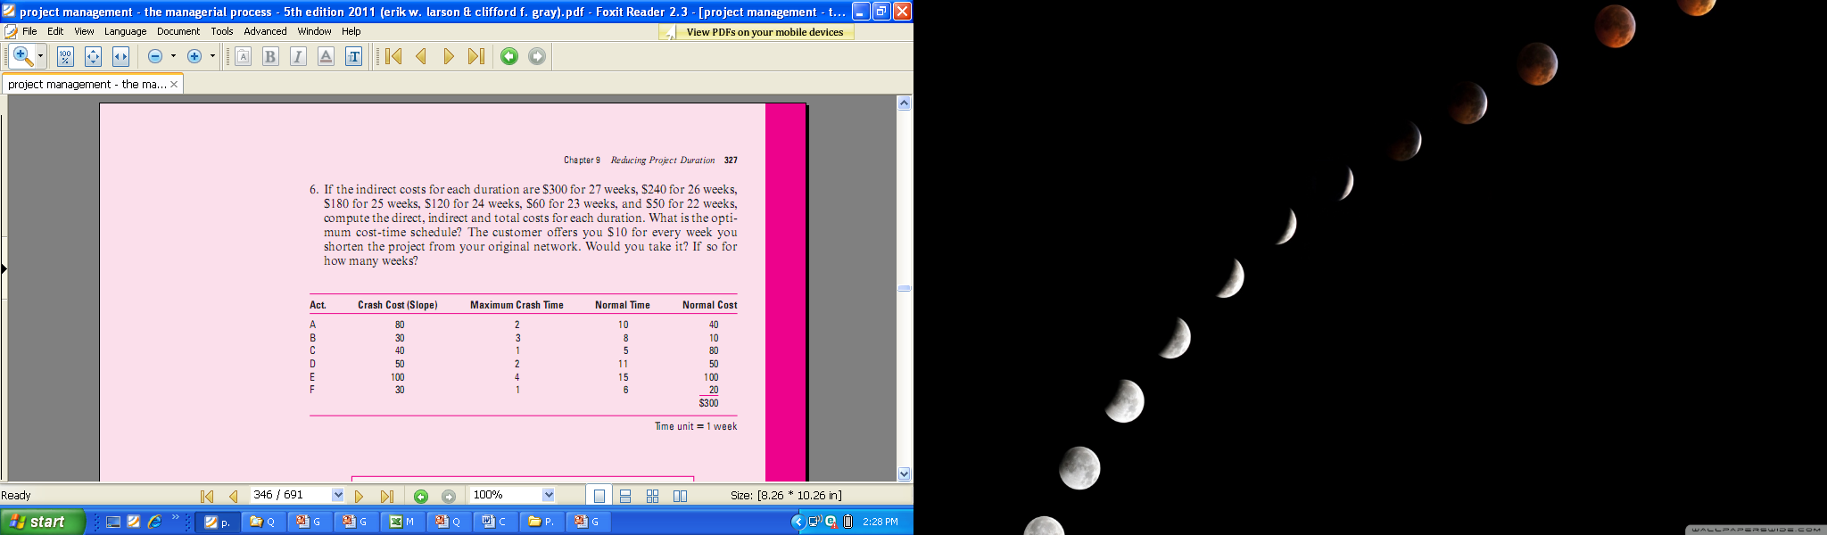
Copyright © 2006 The McGraw-Hill Companies. All rights reserved.
McGraw-Hill/Irwin 9–<number>

Slide 24
Quiz 5
There are some options to accelerate project speed. If your resources are constrained, how many options might you have? Explain and give an example for each option.
Copyright © 2006 The McGraw-Hill Companies. All rights reserved.
McGraw-Hill/Irwin 9–<number>

Slide 25
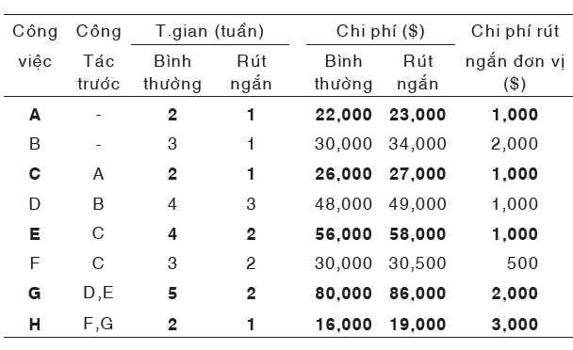
Reducing Project Duration
Reduce the Project Duration until its crash point. Determine the Project cost for each duration.

